Slide 1

to train more facilitators
based on the Westchester
Model
1

Slide 2


The theme of the program is…
2

Slide 3
How is the AVP Program Going in Your Area?.
Do you have enough outside facilitators to maintain your prison program?
Did you train any new facilitators
last year?
Have you conducted any community workshops in your area?
3

Slide 4
AVP Westchester has made a commitment to Thrive
We held 56 workshops in 2019 including 6 community workshops
Our community workshops focus on training new facilitators
We trained 22 new outside facilitators in 2019
4

Slide 5
AVP Westchester has made a commitment to Thrive
For many years we have served Sing Sing, Bedford Hills and Otisvile Prisons
In 2018 we added Garner Men’s Prison in Connecticut
In 2019 we added Taconic Women’s Prison and the Westchester County Jail
5

Slide 6
In this session we will ask three questions:
Have you made a commitment to Thrive?
Are you building an outreach network to recruit new facilitators?
Are you asking the right question?
What are the strategies to help Area Councils Thrive?
6

Slide 7

7

Slide 8

A community workshop program requires effort and commitment
It requires a lot of digging to
plant the seeds
It requires planning and
dedication to succeed
8

Slide 9
It requires recruiting and training new facilitators as your first priority
It may require a bootstrap effort
by people who are already
overworked
9

Slide 10
Small group discussion
Have we made a commitment to Thrive?
Have you made training new facilitators your first priority?
Who will take the responsibility to lead your outreach effort?
10

Slide 11
11

Slide 12
Who are good groups to network with?
Friends of
Facilitators
Quaker
Meetings
Churches
AVP
Westchester
West-
chester MLK
Institute
Other Prison Volunteers
Volunteer
New York
WESPAC
12

Slide 13
Build your network
?
?
?
My AVP
Network
?
?
?
?
13

Slide 14
Start with people that already know about the AVP program.
Join their group before asking them to join your group.
Don’t expect outside groups to come to you.
It is best to have an AVP person who is a member of their group.
14

Slide 15
It is hard to break down doors from the outside.
Look for prospects who are most likely to become facilitators.
Focus on the Baby Boom Generation that is starting to retire.
Build your mailing list
15

Slide 16
Good Facilitator prospects:
– People who want to reduce violence in our society
– Middle-class people who are not working two jobs
to survive
– Post mid-life and retired people who are looking for
a new meaning in their life
– People who have a car and live within 25 miles of
the prisons that you serve
16

Slide 17
17

Slide 18
We have usually been asking people:
“Would you like to take an Alternatives to
Violence Workshop?”
And we usually get the answer,
“I’m not a violent person. Why
should I take an alternatives
to violence workshop.”
18

Slide 19

Then we ask people:
“Would you like to improve your conflict
resolution skills by taking an AVP Conflict
Resolution Workshop?’
And then we whisper,
(If you like the workshop perhaps
you would like to become
a facilitator.)
19

Slide 20
We have found that the right question to ask is,
“Would you like to be come a conflict
resolution workshop facilitator?”
• Many people are concerned about the violence
in Kenosha, Portland and many other cities
• Many people want to do
something to reduce the
violence in our society.
• AVP gives them an opportunity
to do something!
20

Slide 21
What are the results?
We get responses from people who already have great conflict resolution skills…
retired social workers, psychologists and teachers.
Nearly half of the people who have attended our Basic Workshops have become facilitators
22 people attended our Community Training for Facilitators Workshops in 2019.
These are our new leaders.
21

Slide 22
Small Group Discussion:
How will I invite a friend to become an AVP Conflict Resolution Workshop Facilitator?
Practice your elevator talk
22

Slide 23

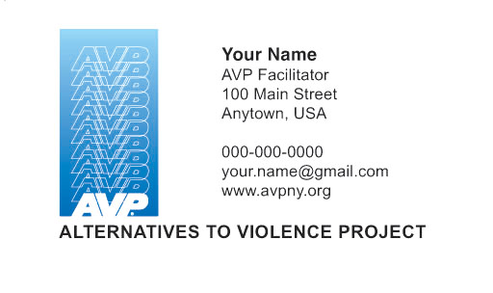
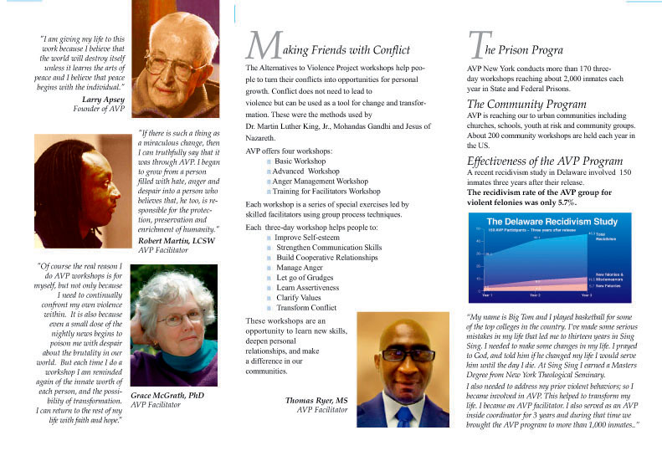
Outreach Tools
Your AVP Brochure
Your
AVP
Business
Card
23

Slide 24

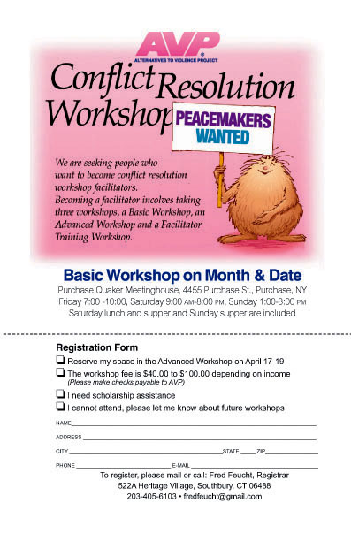
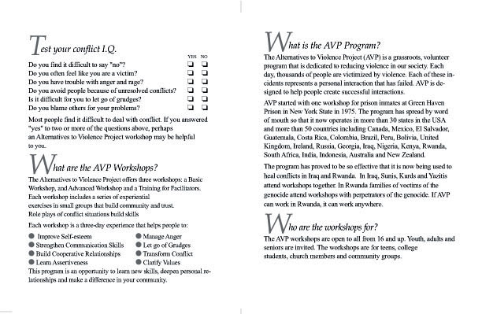

Outreach Tools
AVP
Workshop
Invitations
AVP Workshop Flyer
24

Slide 25
Summary
Make a commitment to Thrive
Build your network
Invite people to become AVP
Conflict Resolution
Workshop
Facilitators
25

Slide 26
Evaluation
Was this session helpful?
What did you learn?
Would you like to organize community workshops in your area?
26

Slide 27

28

